Slide 1
Arduino - Introduction
Science for humanity 2017
MakAIRsjop

Slide 2
Introduction
Robert Haccou
Electrical Engineer
Engineer BPE Avionics
Royal Netherlands Air Force
Main support-base, Woensdrecht Airbase
MakAIRsjop
Innovation centre AIR (Ambition - Innovation – Results)

Slide 3
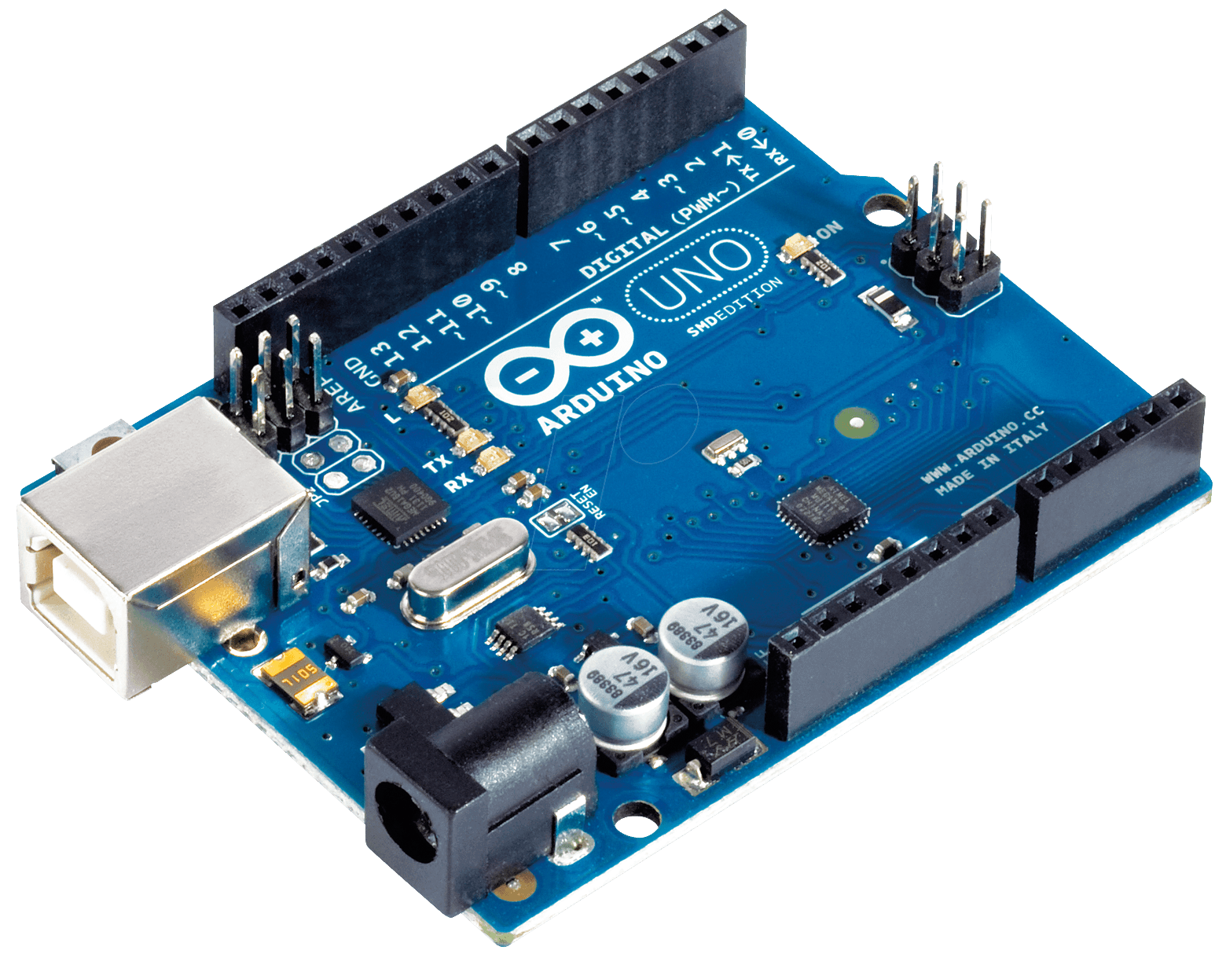
What is Arduino?
Development board
Programmable micro processor (Microcontroller)
(Digital) Electronics
Open source
Read inputs, control outputs!

Slide 4
What can you do with Arduino?
Read inputs
A finger on a button
Light on a sensor
Temperature in a room
Data over communication bus
Or a Twitter message
More!
And turn it into an output
Turning on a LED
Activating a motor
Text on a display
Calculating / Processing
Publishing something online
More!

Slide 5
The short Arduino project for today!
Turn a potentiometer to a certain position (Input)
Can become anything other analog input… (sensor) Another time!
More in’s and out’s… Another time!
Make the servo turn to a certain position (Output)
With Arduino!

Slide 6
Agenda
Theory:
What is a potentiometer?
What is a servomotor?
Signalling a servomotor
How should the program work?
Hands-on:
Wiring on the breadboard!
Programming the Arduino!
Testing!

Slide 7
Theory
What is a potentiometer?
What is a servomotor?
Signalling a servomotor
How should the program work?

Slide 8
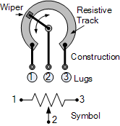
1. What is a potentiometer?
It’s a resistor! (Acts like a normal transistor between pins 1 and 3)
With a variable resistance by turning the ‘wiper’. (Connected to pin 2)
Position can be read as a variable analog voltage. (If used with one of the analog input pins)

Slide 9
1. What is a potentiometer?
Reading with Arduino’s ‘analogRead’ function.
Reads value of somewhere between 0 and 5V.
Returns an integer value between 0 and 1023.
Yields a resolution between readings of: 5 volts / 1024, or: 0.0049 volts (4.9 mV).

Slide 10
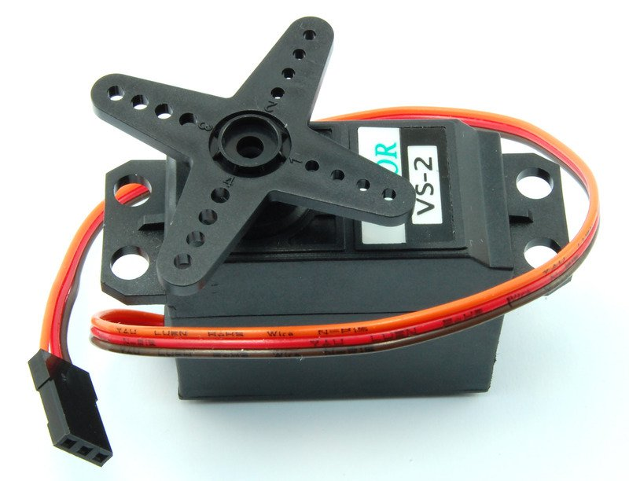
2. What is a Servomotor?
It’s a motor!
Not a typical DC motor (that’s either ON or OFF, at a certain speed)
Not a stepper motor (That turns a step for each pulse)
It’s a motor that turns to a certain position.
Controlled by modulating the on-time of a signal.
So the width of a pulse controls the position of the servo.
Typically operating range is between 0° and 180°, where 90° is default.
Three wires to connect:
Power (Red)
Signal (Yellow/Orange)
Ground (Black/Brown)

Slide 11
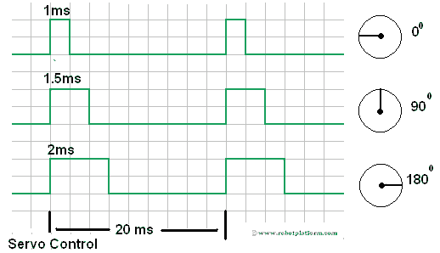
3. Signalling a servo motor
PPM stands for Pulse-Position Modulation.
Time frame for a servo PPM signal is typically 20ms. (50Hz Signal)
On-time determines position. (See image on the right)

Slide 12
3. Signalling a servo motor: Common misconception
Signal is often referred to as ‘Pulse-Width Modulation’ by manufacturers (Because it is).
Causes the misconception that Arduino’s PWM may be used to drive the servo.
Don’t use Arduino’s PWM (analogWrite), because the PWM frequency of this signal is 490Hz, not 50Hz.
(This is why the Servo library exists!)

Slide 13
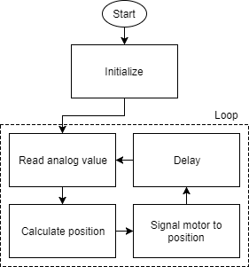
4. What should the program do?
Setup and initialize (standard step in Arduino programming)
Read the analog voltage value of the potentiometer.
Translate the read value, into a position for the servo motor.
Signal the servo motor to go to that position.
Wait for the servo motor to position itself there.
Do it all again, starting from step 2. (Loop)

Slide 14
Hands on!
Wiring on the breadboard!
Programming the Arduino!
Testing!

Slide 15
5. Wiring the Arduino!

Slide 16
6. Programming
Start Arduino IDE
Make a new sketch
Go to: File → New

Slide 17
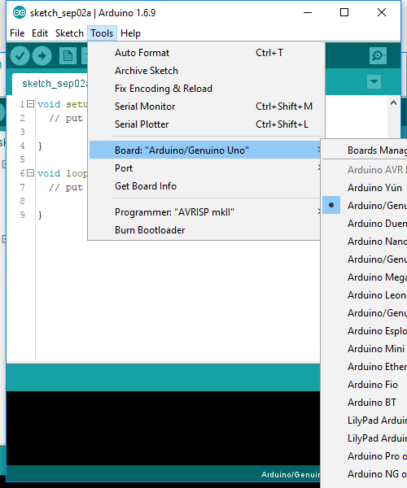
6. Programming
Select the right board
Go to: Tools → Board → Arduino/Genuino Uno
Select the right port
Go to: Tools → Port → (Your com port)

Slide 18
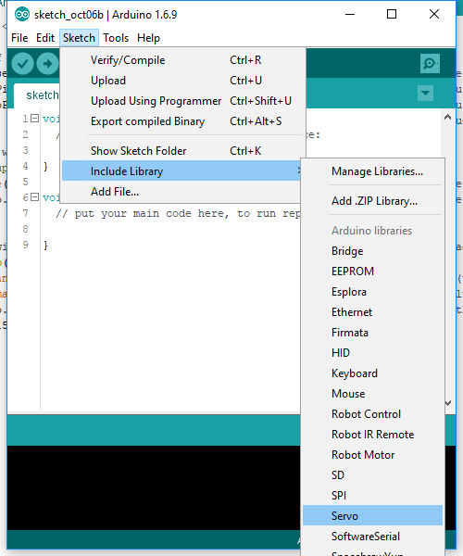
6. Programming
Will be using the servo library.
Include the servo library by:
Going to: ‘Sketch’, ‘Include Library’, ‘Servo’.

Slide 19
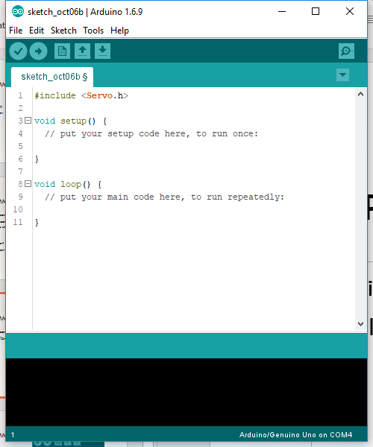
6. Programming
Will be using the servo library.
Or include the servo library by:
Typing the following instruction: #include <Servo.h>
Insert it above the function: void setup() {

Slide 20
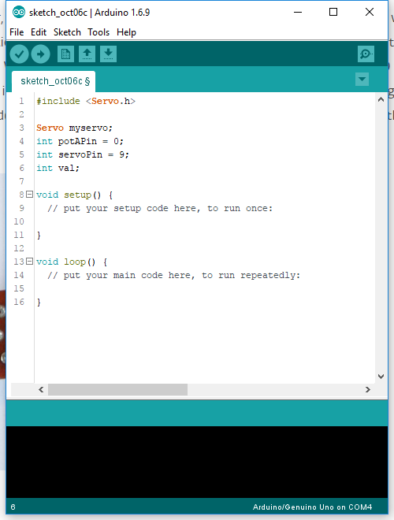
6. Programming
Using servo and variables:
Make an object for your servo
Make variables for: The pin used by the pot-meter, The pin used by the servo, For storing the read value in.
Insert it above the function: void setup() {

Slide 21
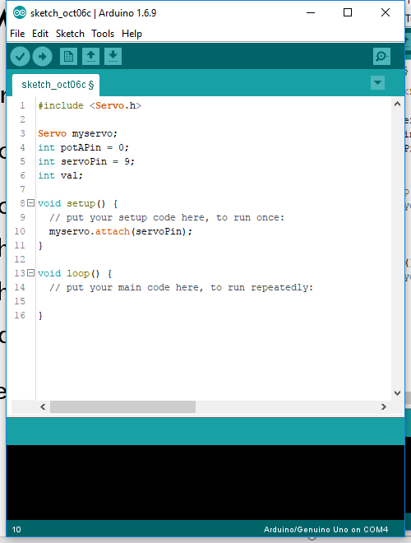
6. Programming
Setting up the servo:
Typing the following instruction in between the { and } of ‘void setup()’:
myservo.attach(servoPin);

Slide 22
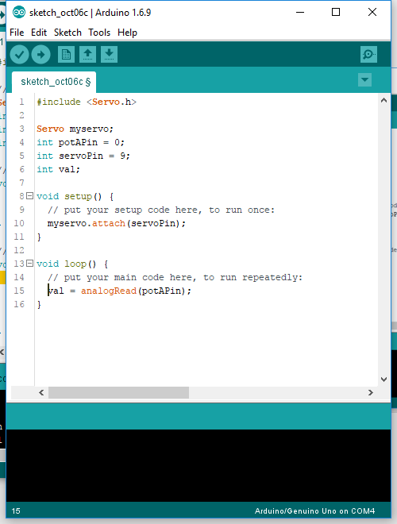
6. Programming
Reading the analog value of the potentio meter:
By using Arduino’s ‘analogRead’ function for your pin.
Storing the read value in your variable ‘val’.

Slide 23
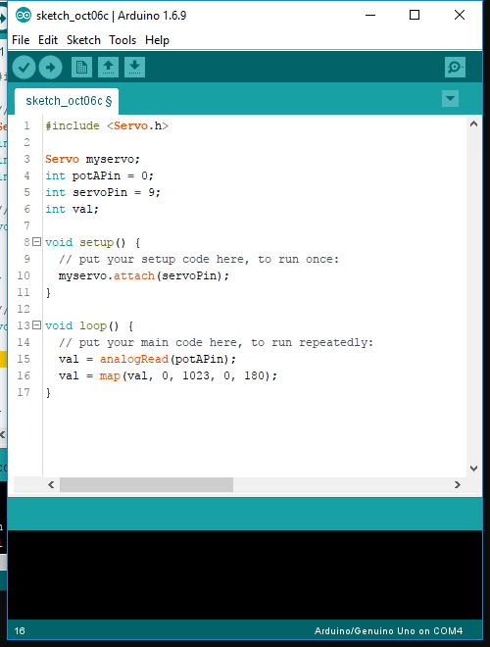
6. Programming
Calculating the position with respect to a 0 to 180 degrees scale.
By using Arduino’s ‘map’ function. (Conversion table function)
Storing the new translated value in ‘val’.

Slide 24
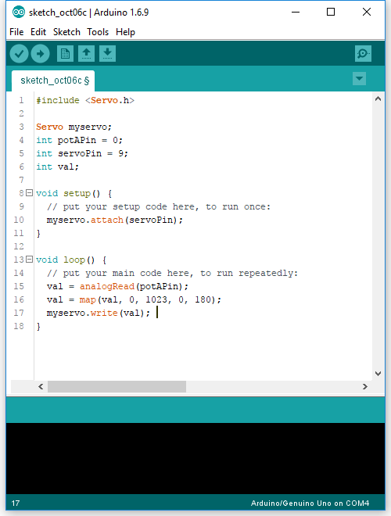
6. Programming
Signalling the servo to the calculated position
By using the write function from the servo library.
Using the calculated value ‘val’.

Slide 25
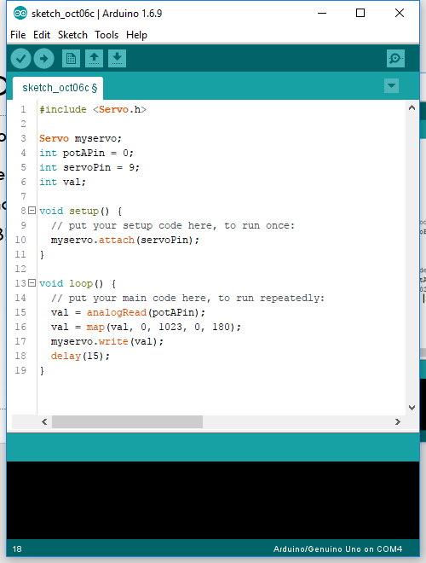
6. Programming
Almost done!
Add a delay in which the servo has time to move from position A to position B! (15 miliseconds)

Slide 26
3. TESTING: Time to upload

Slide 27
3. TESTING
NO NEED TO SAVE!!
DOES IT WORK!?
IF (YES) Yay! You made your first Arduino Project!
IF (NO) No problem, let us help you!

Slide 28
Questions?

