Slide 1
Arduino - Introduction
VSV Breda Airshow 2017
MakAIRsjop

Slide 2
Introduction
Robert Haccou
Electrical Engineer
Engineer BPE Avionics
Royal Netherlands Air Force
Main support-base, Woensdrecht Airbase
MakAIRsjop
Innovation centre AIR (Ambition - Innovation – Results)

Slide 3
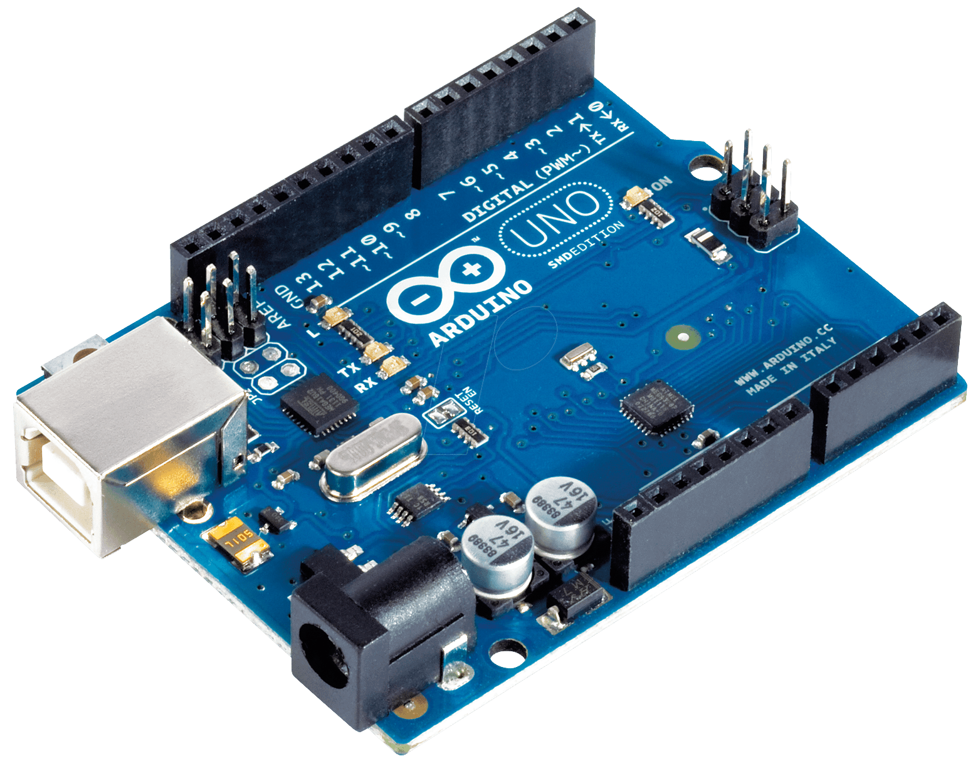
What is Arduino?
Development board
Programmable micro processor (Microcontroller)
(Digital) Electronics
Open source
Read inputs, control outputs!

Slide 4
What can you do with Arduino?
Read inputs
A finger on a button
Light on a sensor
Temperature in a room
Data over communication bus
Or a Twitter message
More!
And turn it into an output
Turning on a LED
Activating a motor
Text on a display
Calculating / Processing
Publishing something online
More!

Slide 5
Your first Arduino project!
Turn a LED ON and OFF (Output)
Can become anything… Another time!
More in’s and out’s… Another time!
With Arduino!

Slide 6
But, how?
Wiring on the breadboard!
Programming the Arduino!
Testing!

Slide 7
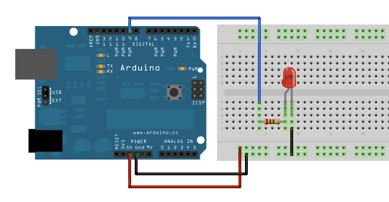
1. Wiring the LED!
LED may be on any of the digital IO’s illustrated on the top of the Arduino)
Please note!: The LED must be wired with the long leg to the Arduino!

Slide 8
2. Programming
Start Arduino IDE
Make a new sketch
Go to: File → New

Slide 9
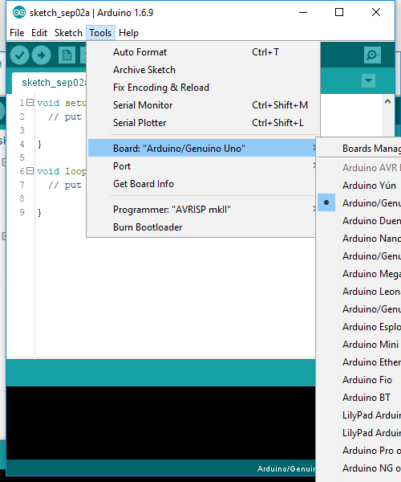
2. Programming
Select the right board
Go to: Tools → Board → Arduino/Genuino Uno
Select the right port
Go to: Tools → Port → (Your com port)

Slide 10
2. Programming
Now we can start coding!
Make a variable ‘LED’ for your pin number!
int LED = 9;

Slide 11
2. Programming
Now we can start coding!
Initialize your pin as an INPUT or as an OUTPUT.
Use the function ‘pinMode’
pinMode(LED,OUTPUT);

Slide 12
2. Programming
Now we can start coding!
Use the function ‘digitalWrite’ to write a HIGH or LOW signal the LED go ON and OFF.
digitalWrite(LED, HIGH);
digitalWrite(LED, LOW);

Slide 13
2. Programming
Now we can start coding!
Use the function ‘delay’ to do nothing for a period of times in miliseconds
delay(1000); delays for 1second.

Slide 14
3. TESTING: Time to upload

Slide 15
3. TESTING
DOES IT WORK!?
IF (YES) Yay! You made your first Arduino Project!
IF (NO) No problem, let us help you!

Slide 16
Questions?

